Slide 1
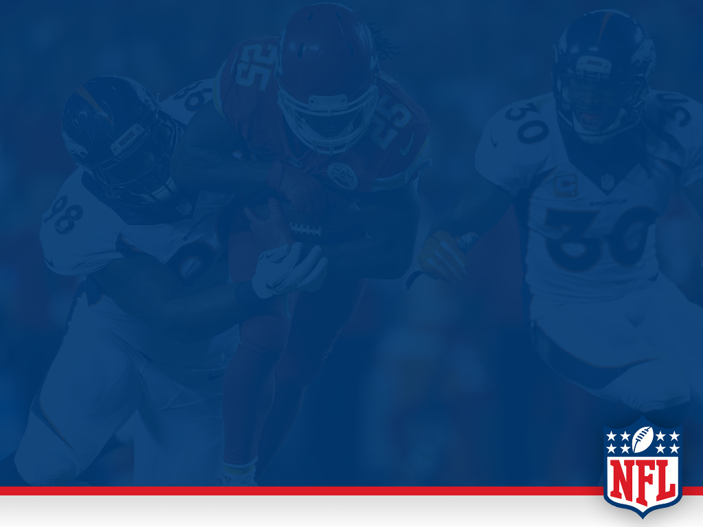
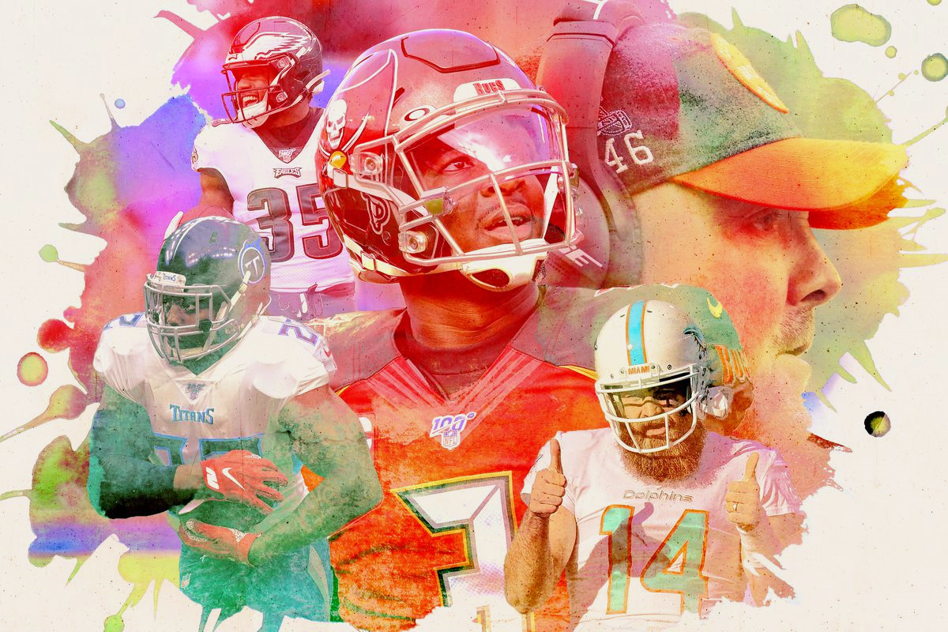
NFL ANALYSIS

Slide 2



MEET THE GROUP 13
Linus Koglin
Geet Sethi
Sukhil Babu
MS in Engineering Management
MS in Engineering Management
MS in Industrial Engineering

Slide 3
OVERVIEW
Throughout this project, the team analyzed 5 data sets to gather information on the National Football League (NFL). The project is broken up into three sections regular season Superbowl, and fan base, and then all the sections are combined to form a conclusion. Each section is broken up into smaller subgroups to find trends and relationships. ​
Superbowl ​
Wins and Loses​
Location​
Advertisements​
Regular Season​
Points Scored vs Conceded​
Wins vs Loss​
Team Spending​
Highest Paid Positions​
Fan Base​
Sport Comparison​
Race of Fans​
Team Popularity​

Slide 4
Superbowl

Slide 5
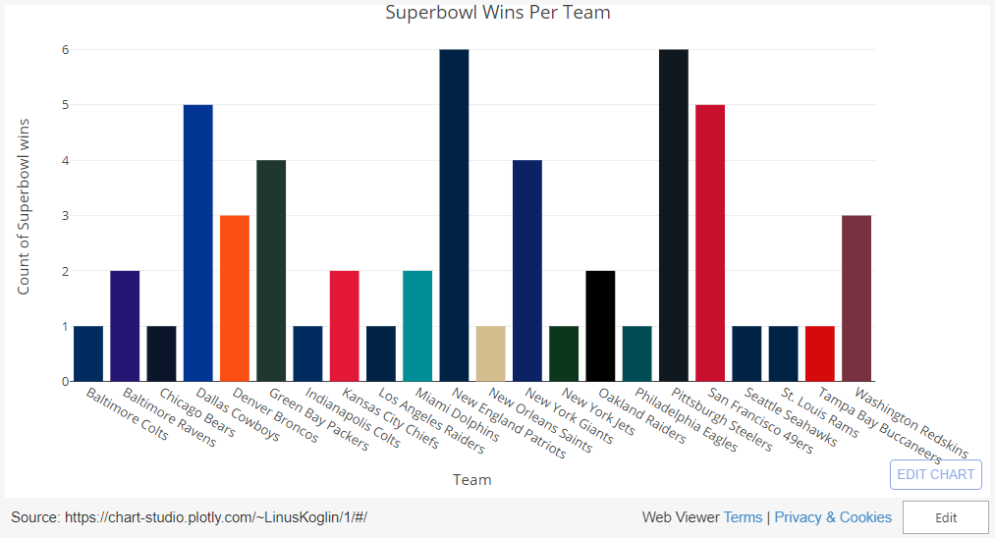
Superbowl Winners

Slide 6
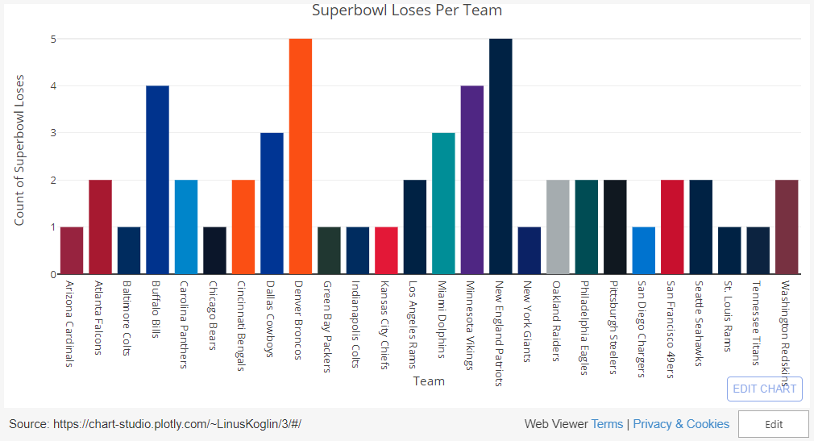
Superbowl Losers

Slide 7
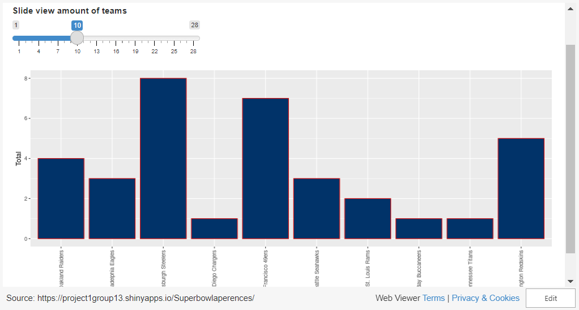
Superbowl Appearances

Slide 8
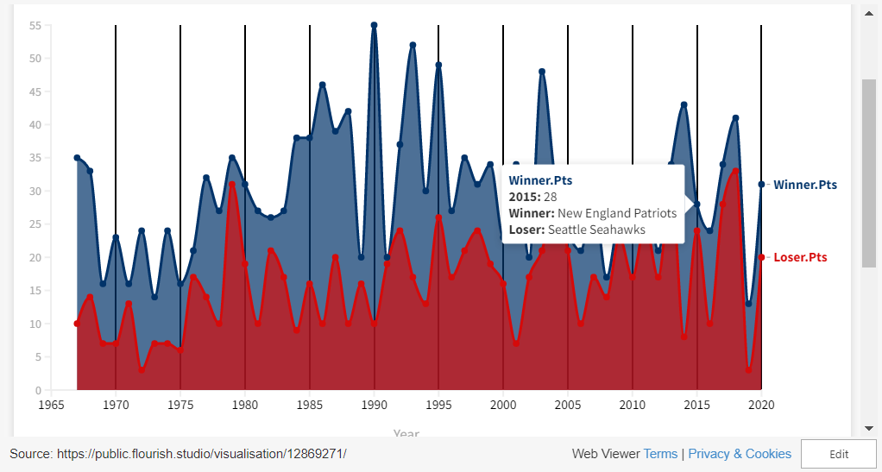
Superbowl Scores (1967 - 2020)

Slide 9
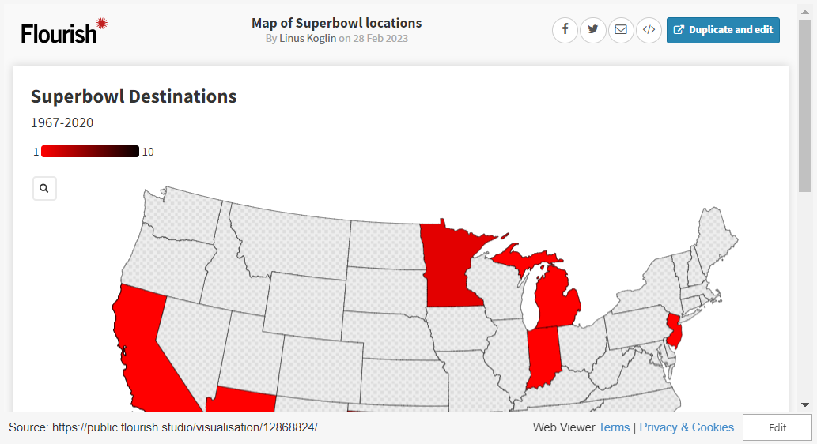
Superbowl Location

Slide 10
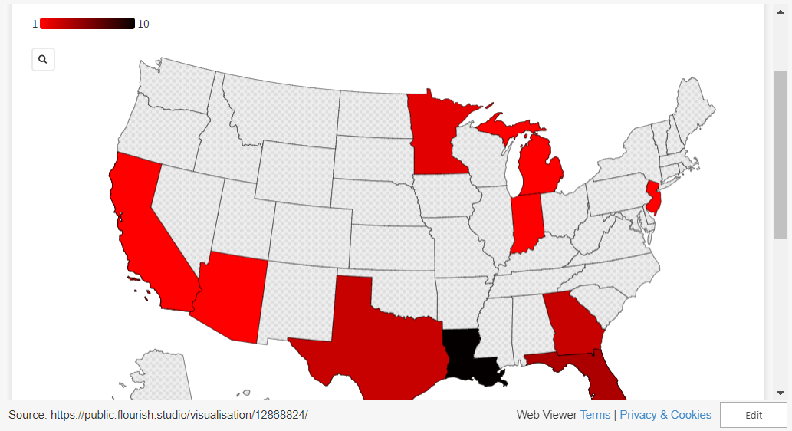
Superbowl Advertisement

Slide 11
Superbowl Advertisement

Slide 12
Regular Season

Slide 13
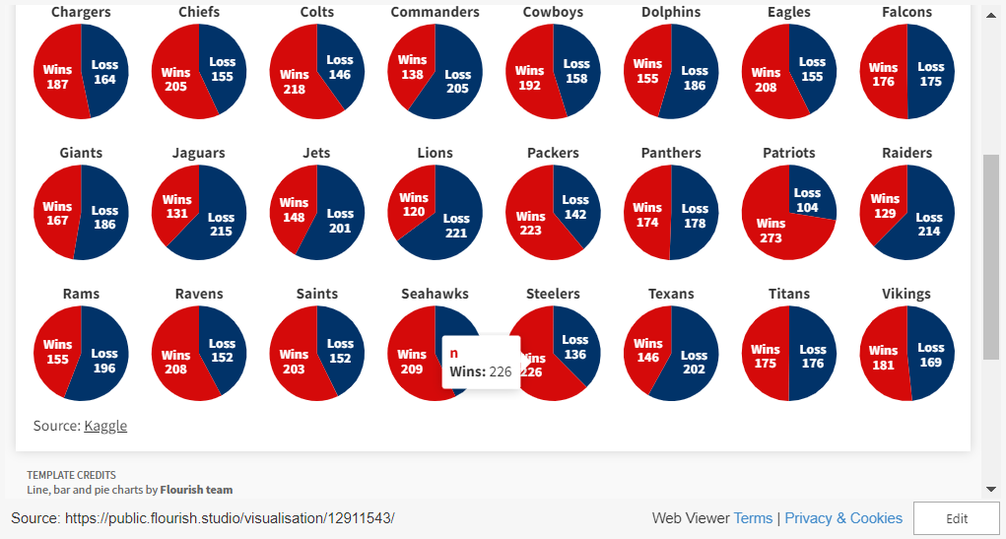
NFL Wins vs Loses

Slide 14
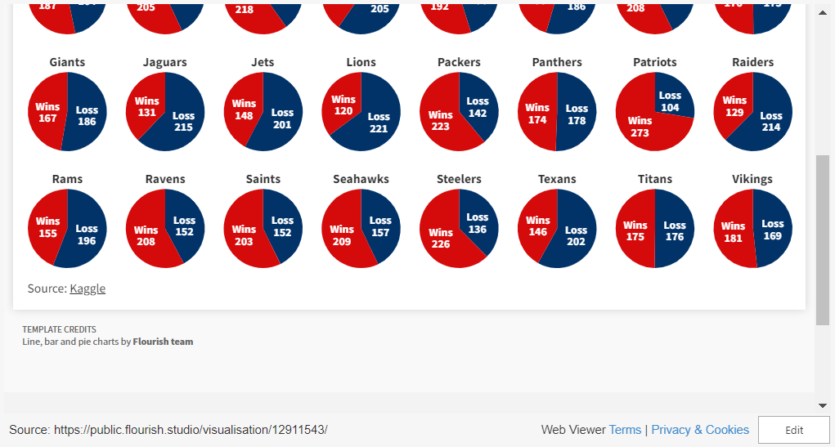
NFL Scores

Slide 15
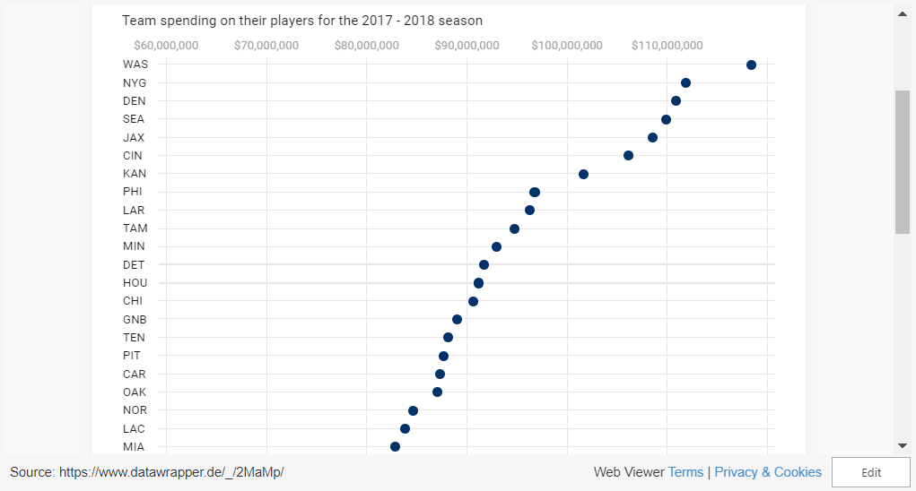
NFL Teams Spending in One Season

Slide 16
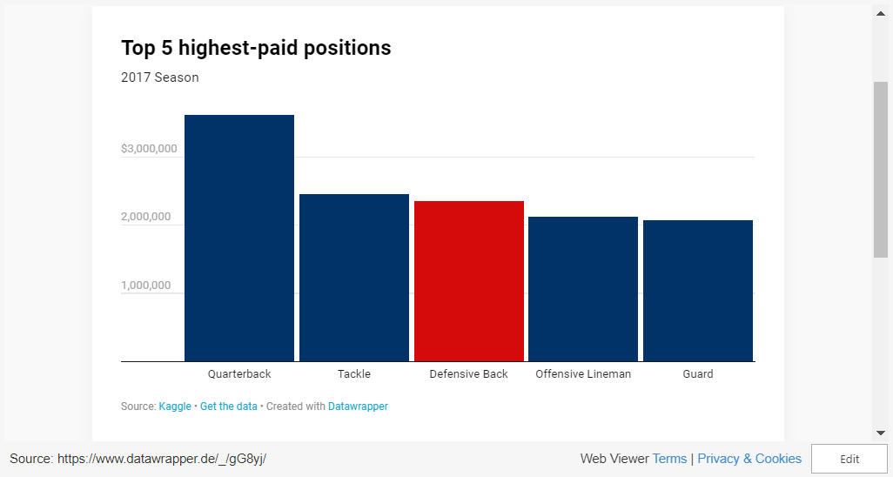
Top 5 Highest-Paid Positions

Slide 17
Fan Base

Slide 18
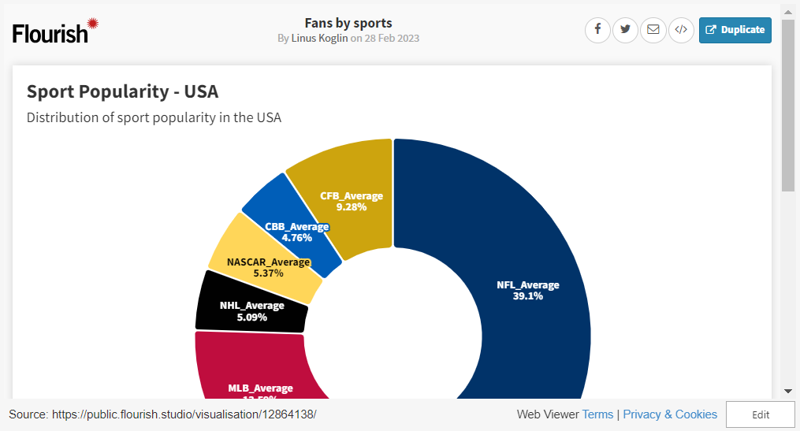
Sports Popularity in the US

Slide 19


Slide 20
Summary
Superbowl
The Patriots and The Steelers' have won the most (6 times).
The Patriots have the most Superbowl appearances (11 times)
4 teams have never made it to the Superbowl
Regular Season
The Patriots have the highest win rate (72.4%) and The Lions have the worst (35.2%).
The Washington Commanders spend the most money and the Cleveland Browns spend the least.
The most spending is done on the offense and primarily on the Quarterback.
Fan Base
NFL has the most fans out of all sports in the USA.
Green bay Packers and Dallas Cowboys have some of the biggest fan bases.

Slide 21
Overall Summary
Overall, it can be determined that the New England Patriots have had the best franchise history. They have the most Superbowl wins tied with the Steelers at 6 and the most Superbowl appearances at 11. Additionally, the New England Patriots have the highest win percentage at 72.4%. Overall this is all supported by one of the largest fan basis in the NFL

Slide 22
Thank You

